Slide 1
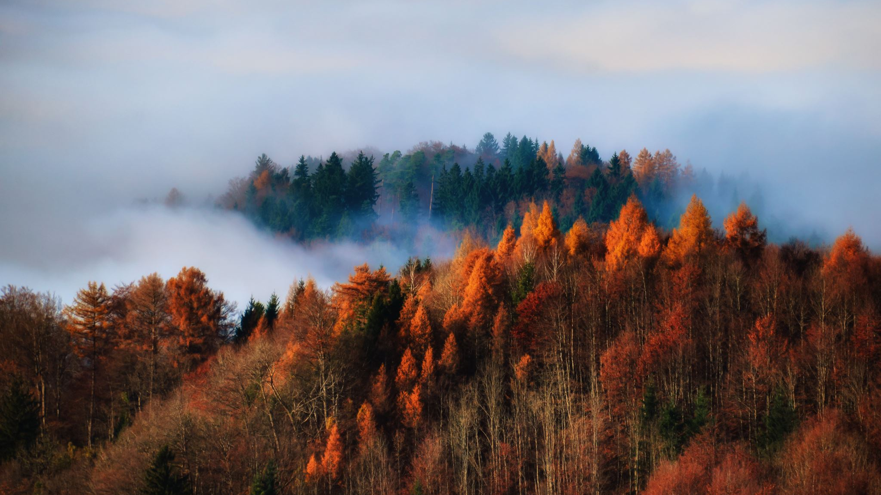
US Wildfires
An analysis of Data collected over 23 years

Slide 2
Topic Overview
Background
Problem
Dataset
Analysis and Result
Machine Learning
Conclusion
Recommendation

Slide 3
Background
Wildfires create economic and ecological damage while endangering human lives.
Fast detection is a key element for controlling such a phenomenon.
Each year millions of forest hectares are destroyed all around the world.
USA is fighting wildfire problems for decades.
In California alone, we witnessed some of the deadliest and most destructive fires in state history.
Billions of dollars have been spent by the various agencies to control and extinguish the fires.

Slide 4
Problems
Is Global warming affecting the number of fires? Has the number of fires increased over the period 1992-2015?
Are we able to limit fire spread with help of growing technology? Has the size of fire decreased over years?
What causes the most fires? Which causes are associated with larger wildfires?
Which State in the USA is most affected by Wildfires? Which county is more prone or less prone to Wildfire?
What is causing more fires in each state?

Slide 5
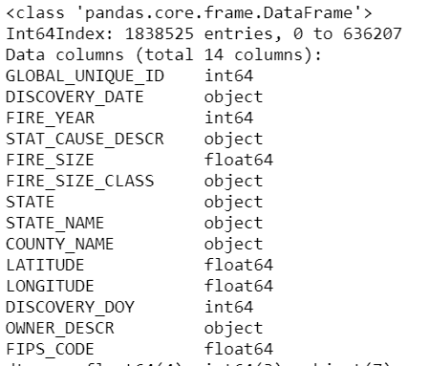
Dataset
This data publication contains a spatial database of wildfires that occurred in the United States from 1992 to 2015.
It includes 1.88 million geo-referenced wildfire records, representing a total of 140 million acres burned during the 24 years.
14 relevant features and 1838525 entries were focused.

Slide 6
Data Wrangling
Dropped columns in SQL table "fires” which were related to Source of data and agency information which collected or prepared reports on Data.
Dropped columns with more than 50% of its total data with null values.
Filled the missing values of COUNTY_NAME column using 'LATITUDE' and 'LONGITUDE' columns.
Converted "DISCOVERY_DATE“ column to a readable date format from Julian date.
Created a column FIPS_CODE with FIPS code value for each County Name.
Checked if there were any outliers with respect to the FIRE_YEAR column.

Slide 7
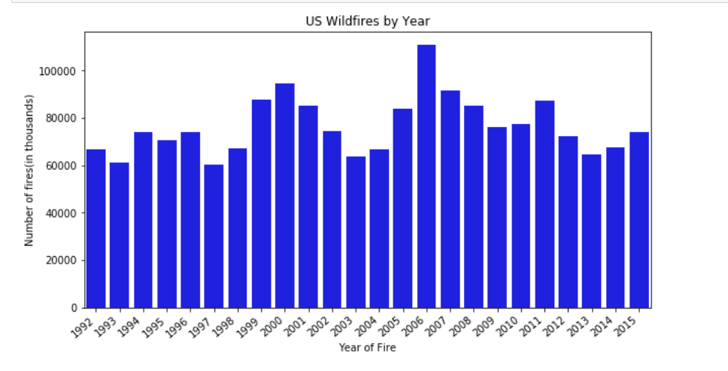
Number of fires over the period of 1992-2015
The number of fires per year ran between 60,000 and 100,000 from 1992 to 2015.
There was a spike in fires in 2006.
Though we can see a small upward trend at certain time periods, there is no continuous upward trend over the period.

Slide 8
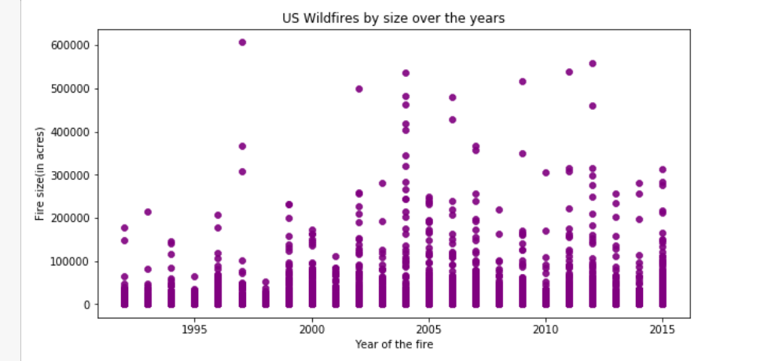
Wildfire size over the years
There is no decrease or increase of fire size from 1992-2015.
Every year has recorded fire of different sizes.

Slide 9
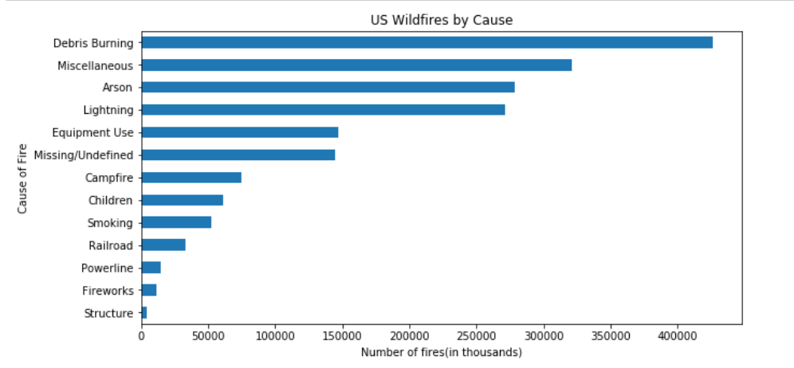
What causes the most fires?
Trash burning was the largest cause of wildfire by a significant margin.
Slightly more fires were started by arson than by lightning
Interesting to note that one reason is just ‘Children’.

Slide 10
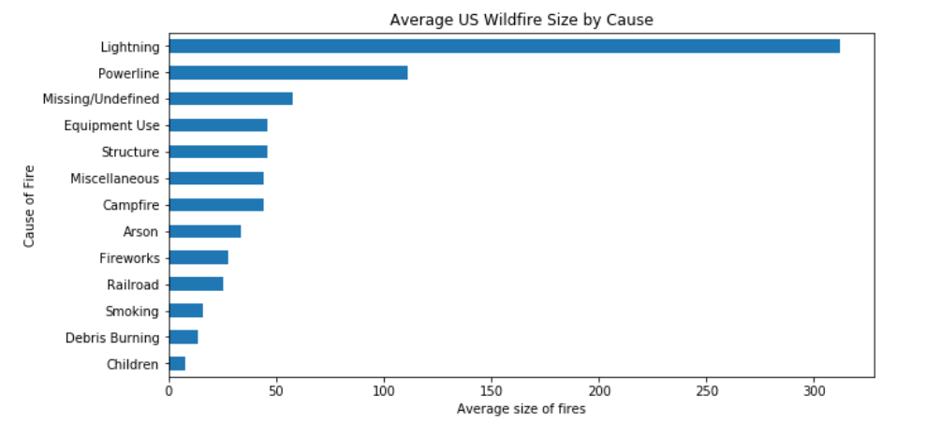
Relationship between cause and fire size?
We can observe that fires started by ‘Lightning’ are the most damaging.
Though the number of fires caused by debris burning is large in number, the average size of the fire caused by it is very low.

Slide 11
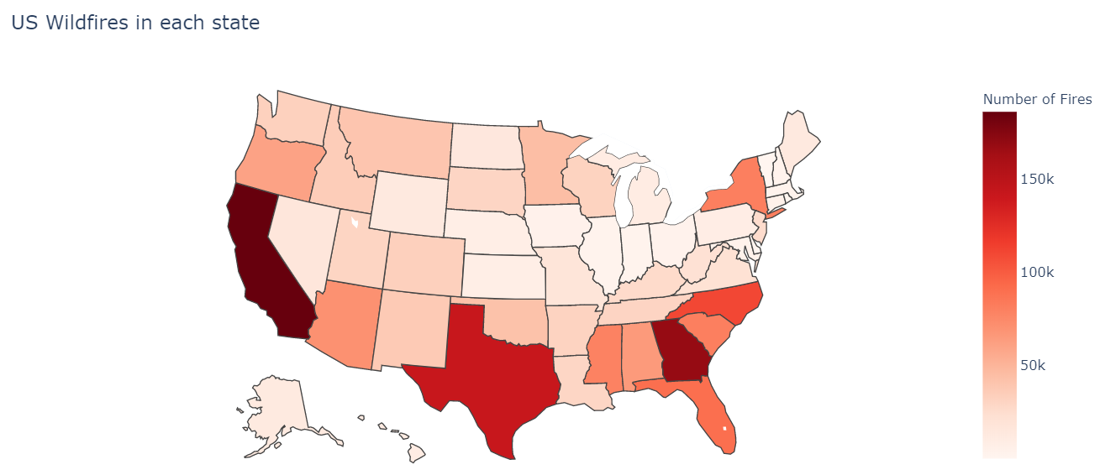
Wildfires in each state of USA
California and Texas have the most wildfires.
Surprisingly, Georgia which is much smaller state than Texas has larger number of wildfires than Texas.

Slide 12
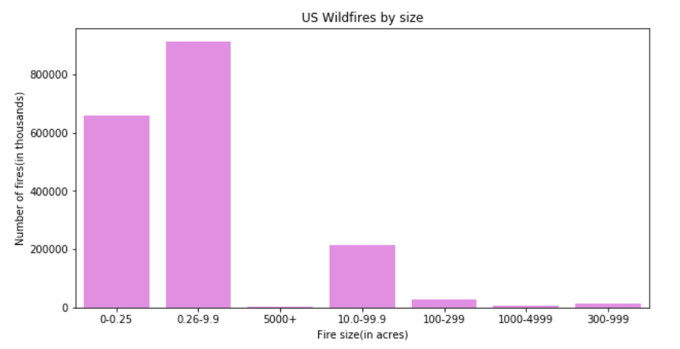
Wildfires by size
Over 800k of total fire incidents are in between 0.26-0.99 acres within the final fire perimeter expenditures.
The number of wildfires reported which have caused damage to more than 1000 acres are comparatively less

Slide 13
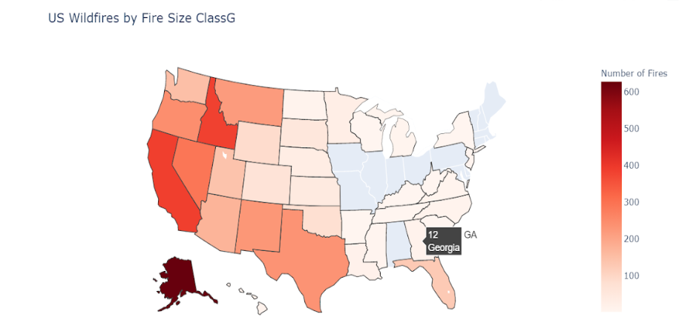
Wildfires in each state with respect to fire size
From Dataset we know that
Size 'A' represents '0-0.25' acres
Size 'B' represents '0.26-9.9' acres
Size 'C' represents '10.0-99.9' acres
Size 'D' represents '100-299' acres
Size 'E' represents '300-999' acres
Size 'F' represents '000-4999' acres
Size 'G' represents '5000+' acres.
Georgia has 12 fires over the span of two decades which are of size ‘5000”’ acres
Alaska has the large number of fires of largest size

Slide 14
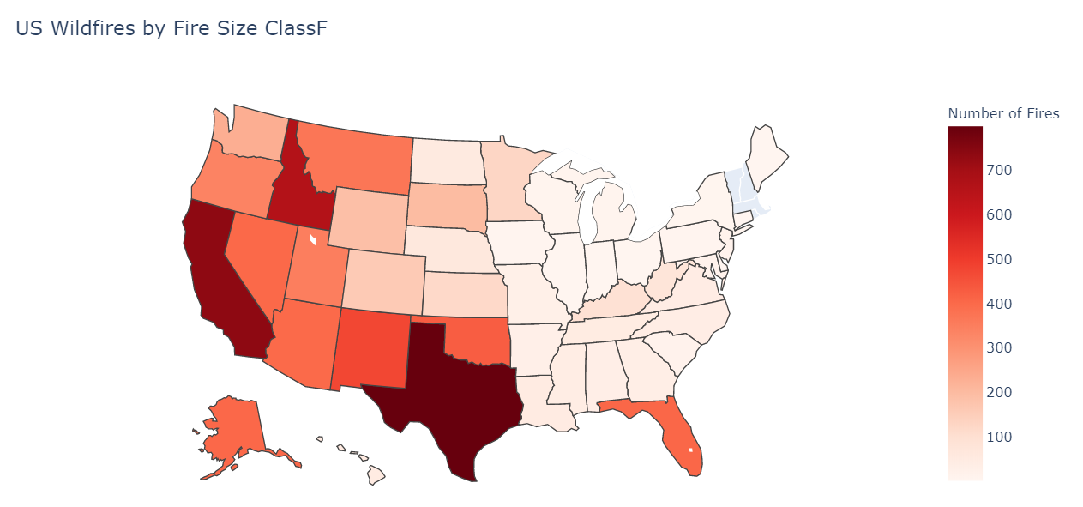
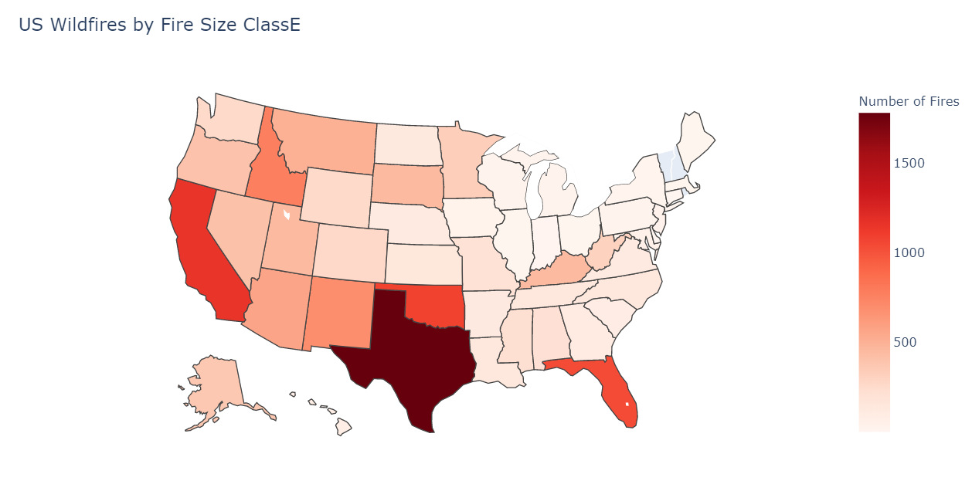
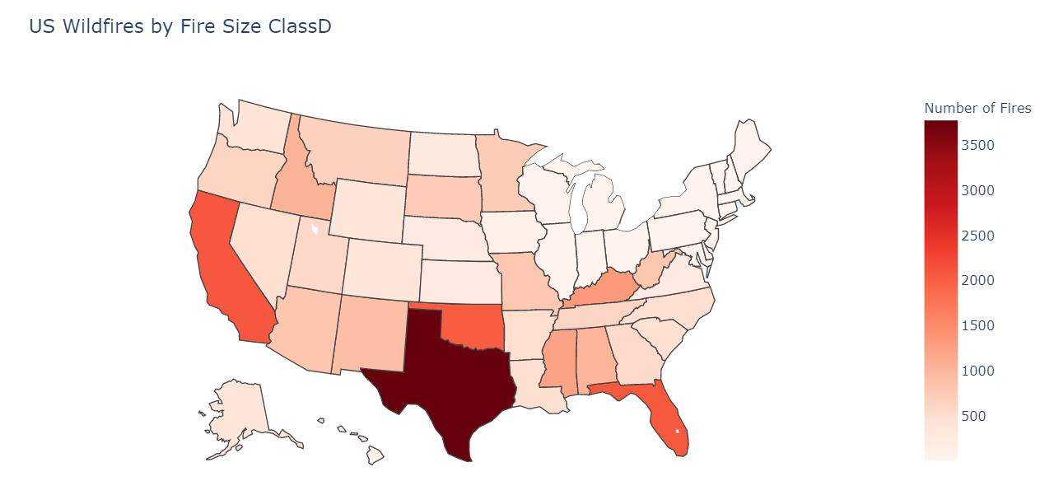
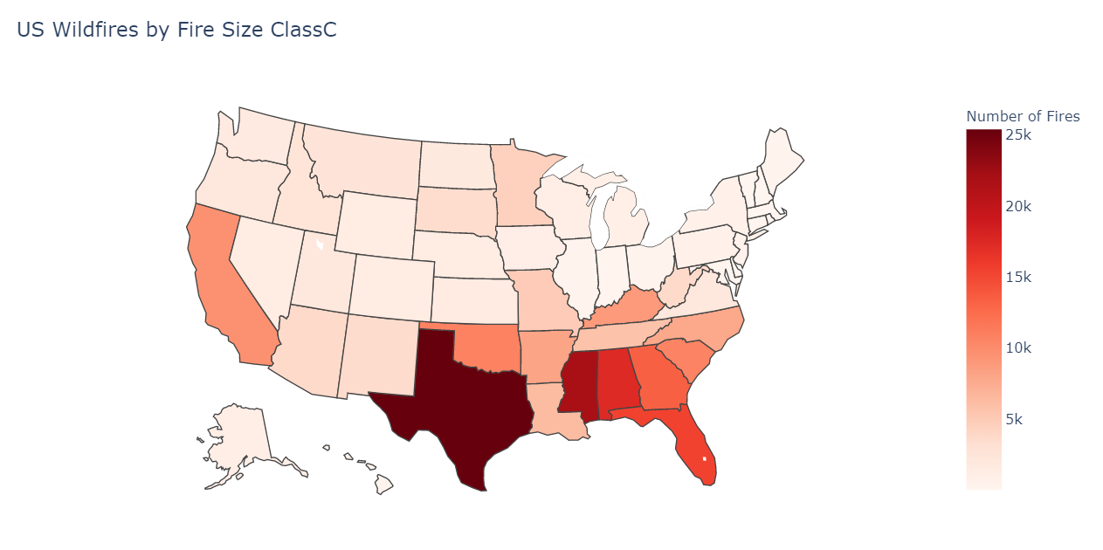

Slide 15
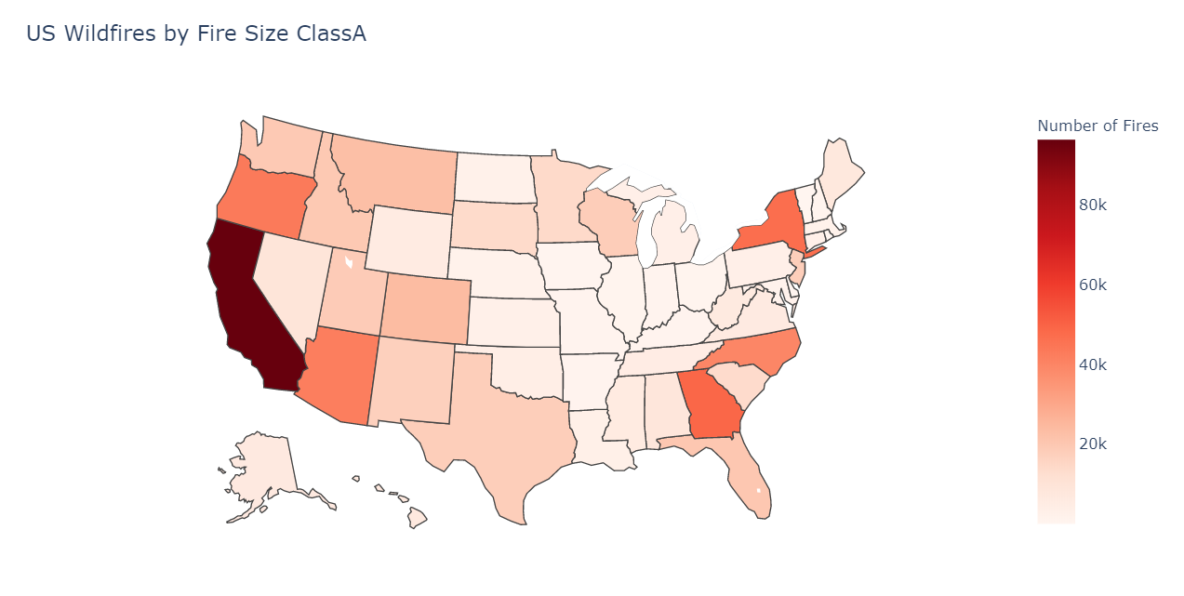
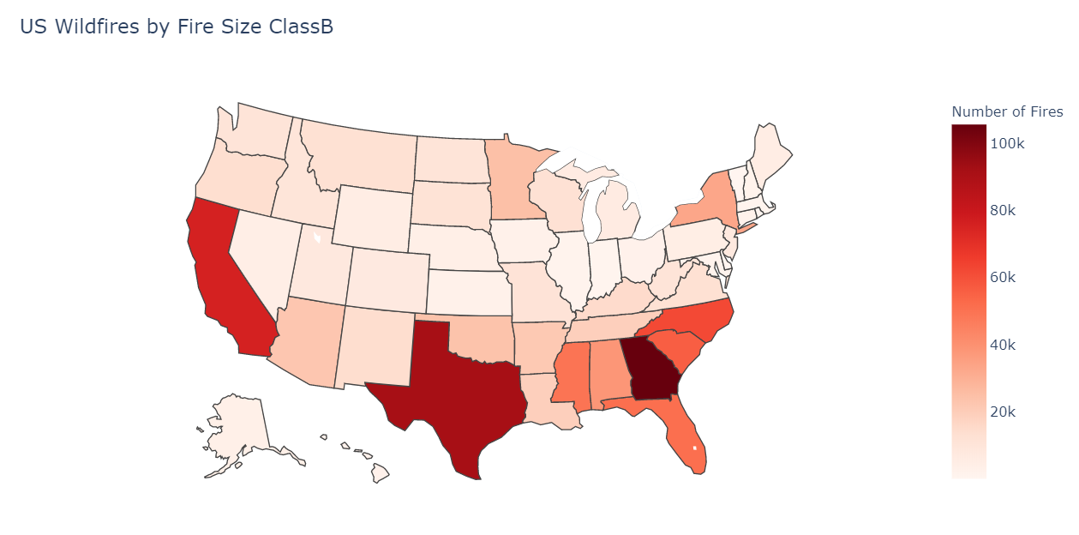
After looking at State maps by Fire size class, we can note that Georgia has most fires with size under 100 acres.
California and Texas have reported fires of all sizes in more numbers over two decades.

Slide 16
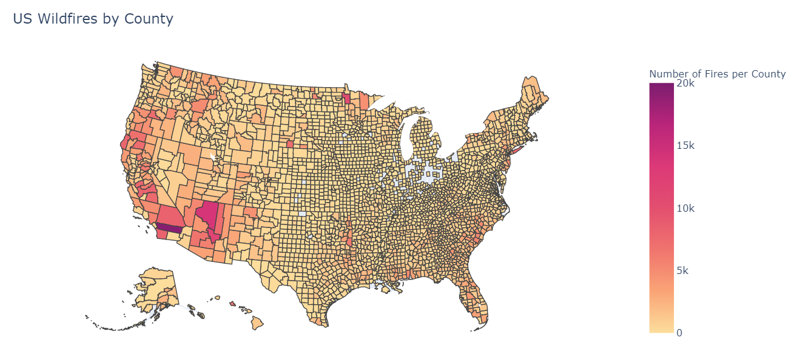
Which County is more prone to Wildfires in USA?
“Riverside County” in California has the most numbers of wildfires.
Below counties comes next in the top list.
“Coconino” and “Gila” in Arizona
“Beltrami” in Minnesota
“San Bernardino” in California
“San Diego” in California
Number of fires are more in counties of California, Arizona, Minnesota, and New York.

Slide 17
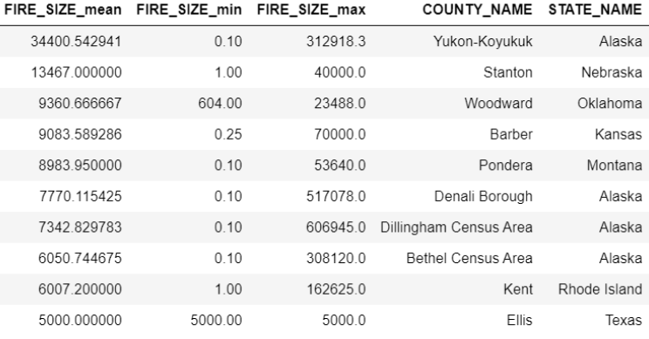
Which counties are most affected in terms of acres of land burnt due to wildfire?
Yukon-Koyukuk is the most affected county over the period.
More destructive fires are reported in counties of Alaska, Nebraska, and Oklahoma.
Riverside County of California reported 19398 fire incidents over 13 years with the average fire size being approximately 31 acres.
Yukon-Koyukuk county of Alaska reported only 51 fire incidents over the same period but with an average fire size of approximately 35000 acres.

Slide 18
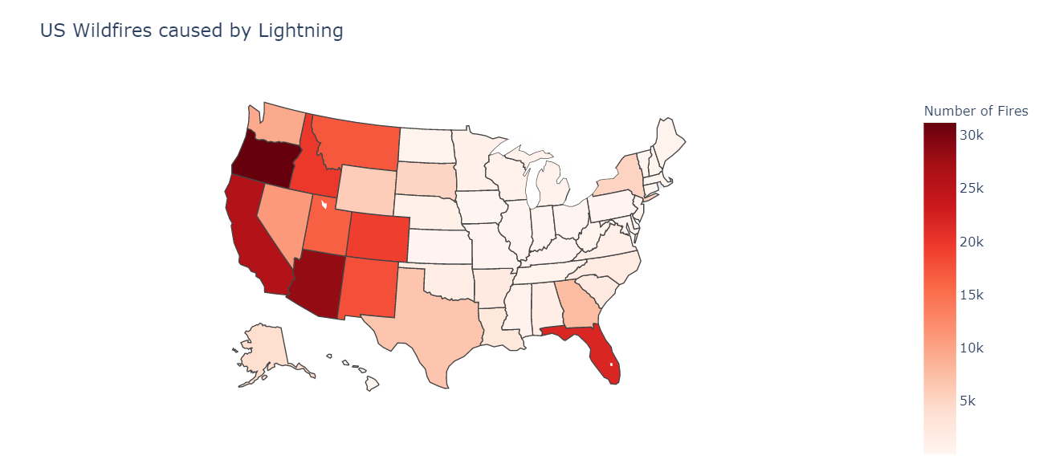
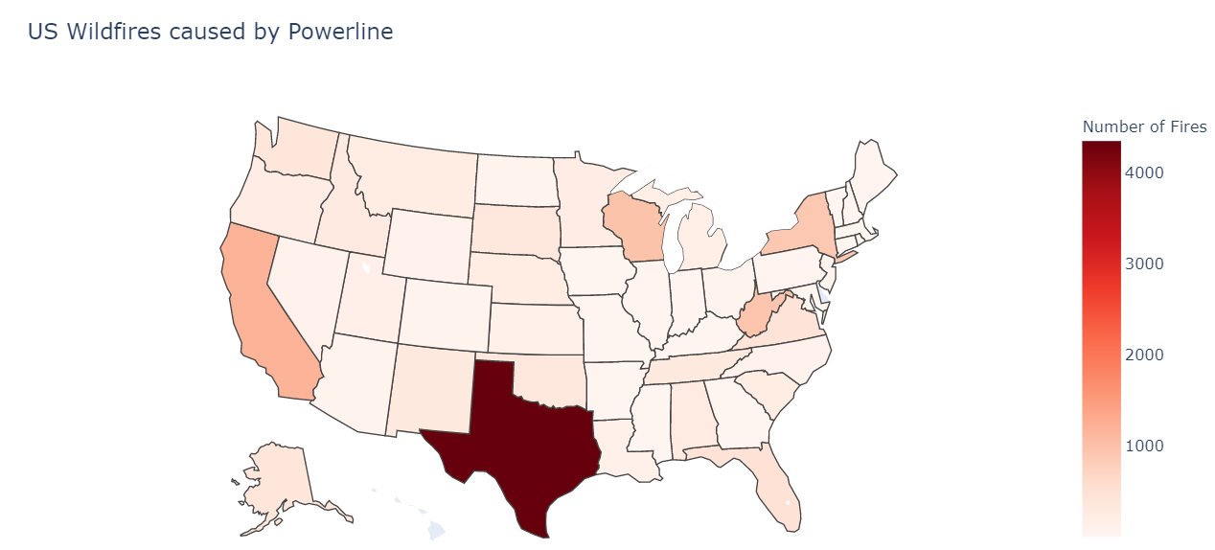
Wildfires in each state with respect to Cause of Fire
The west states of USA has recorded most wildfires caused by “Lightning”.
Florida has recorded 21.8k wildfire caused by lightning
“Powerline” has been stated as cause for over4k wildfires in Texas alone.

Slide 19
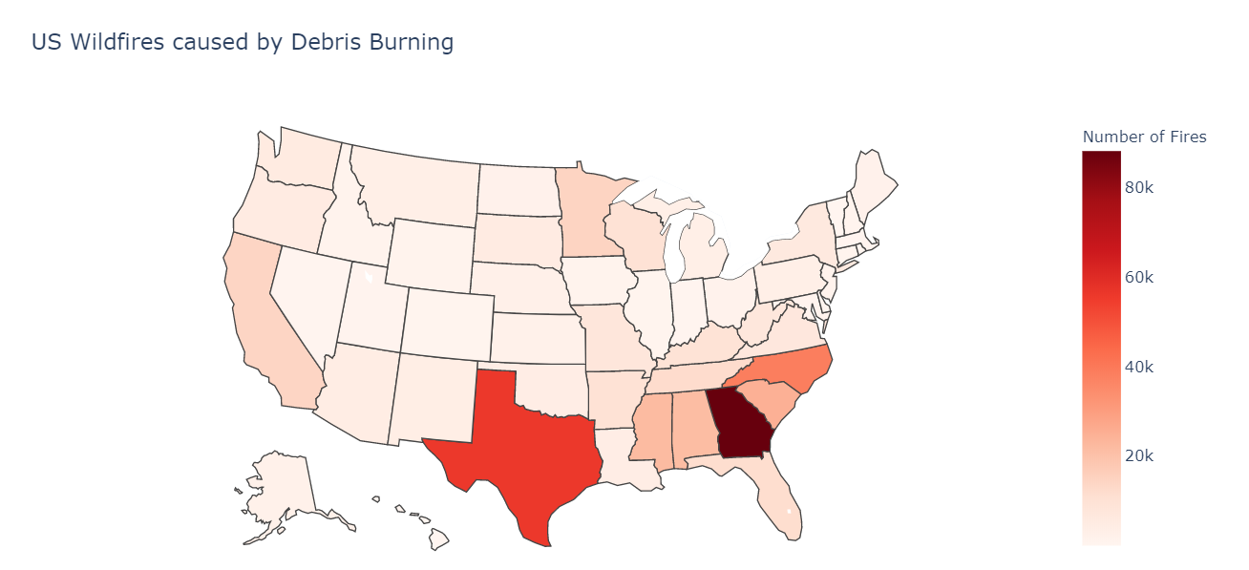
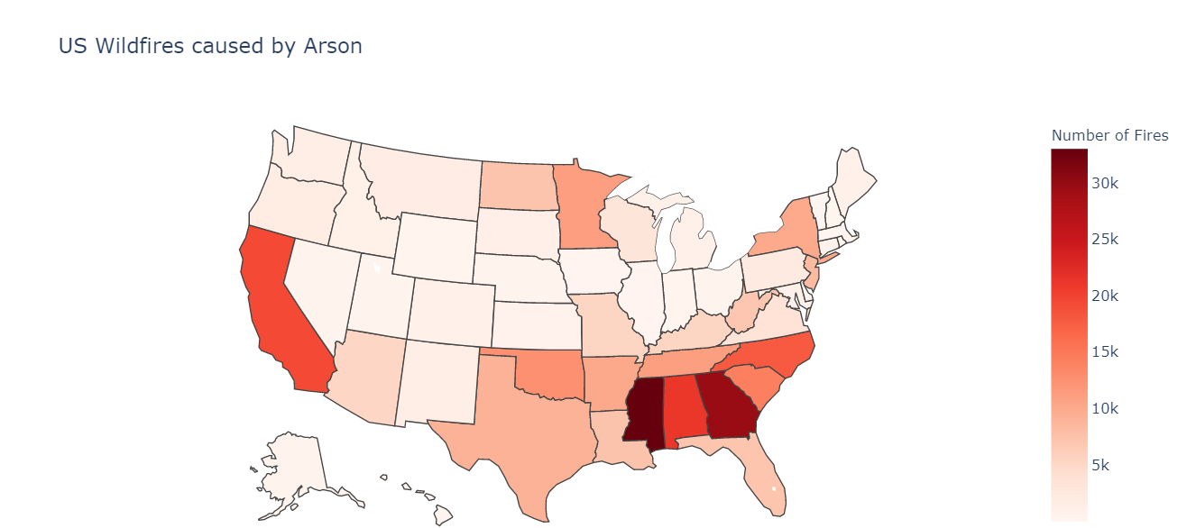
Trash burning is the cause for almost all the cases in Georgia.
Mississippi has 30k wildfires caused by trash burning and arson alone.

Slide 20
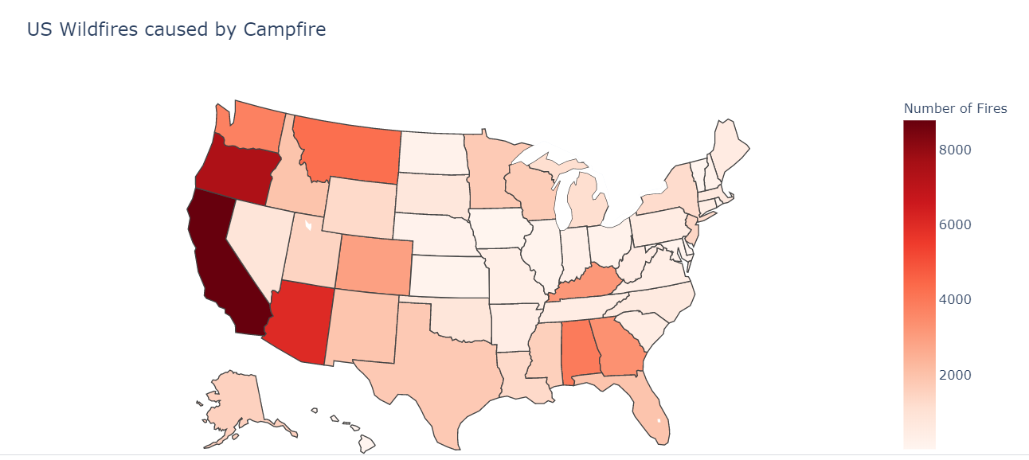
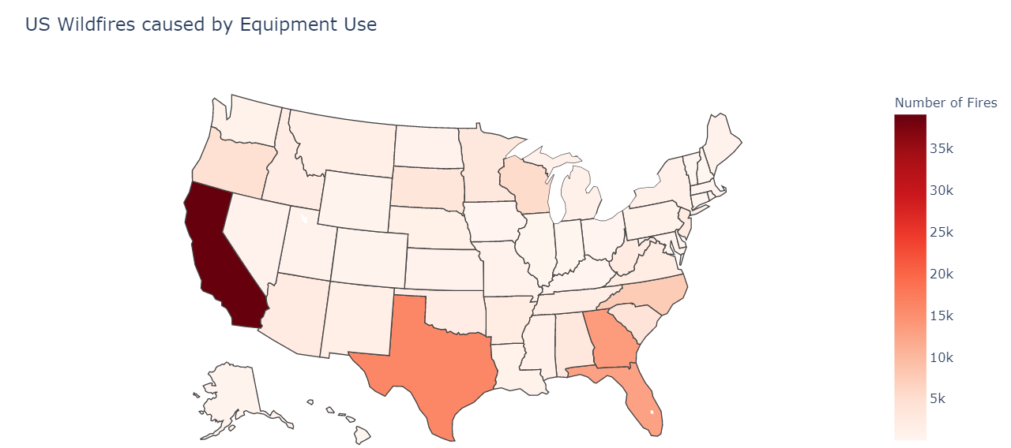
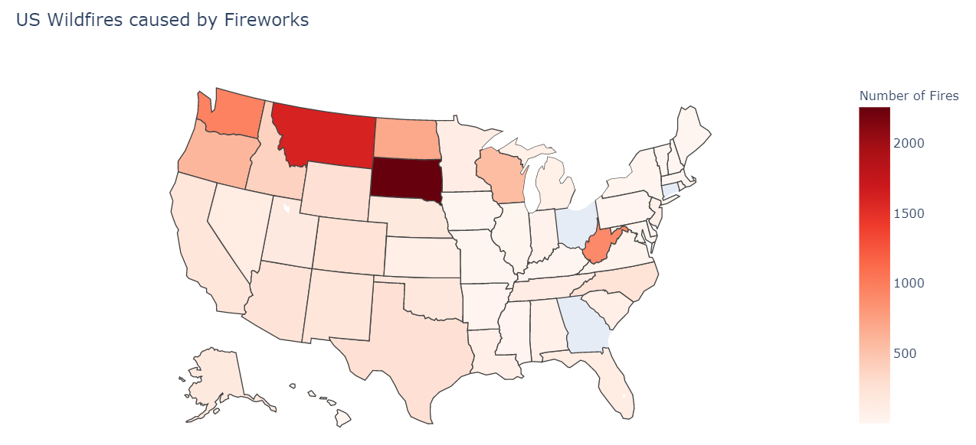
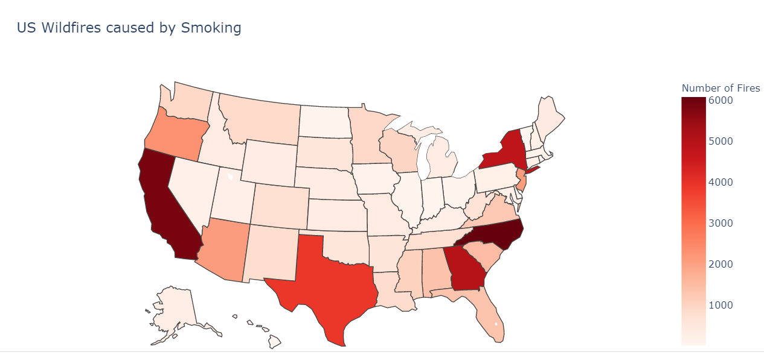

Slide 21
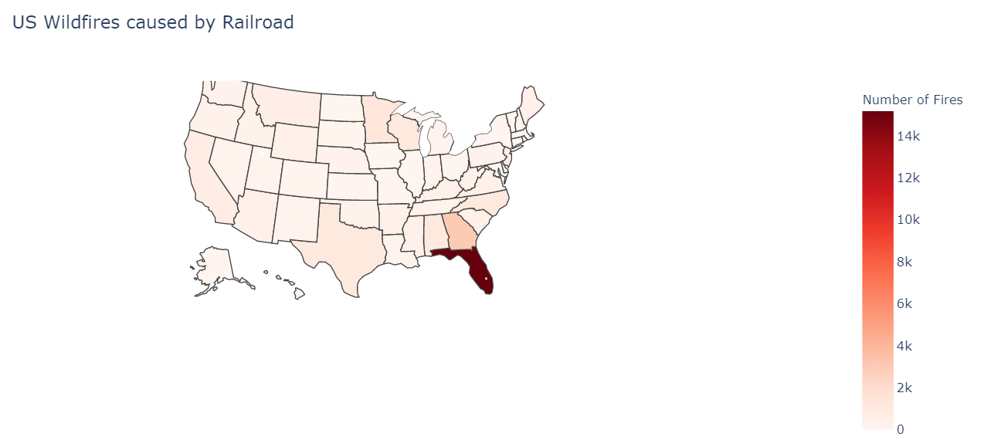
Railroads are causing about 14K wildfires in Florida.
only state majorly affected by Railroad caused wildfires.

Slide 22
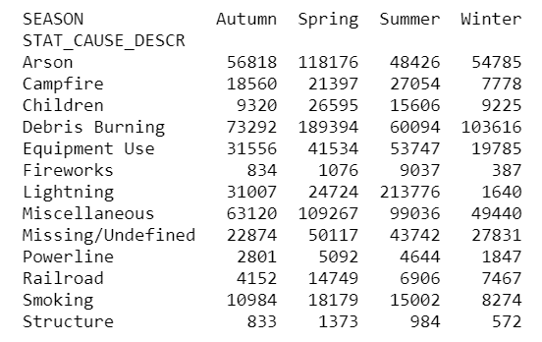
Is the cause of wildfire related to season?
chi-square Test
H0(null hypothesis): The features Cause of Fire and Season are independent (which means they are not associated).
H1(alternate hypothesis): Cause of Fire and Season are not independent (which means they are associated).
p-value=0.000000
At 0.05 level of significance, we reject the null hypothesis and accept H1.
They are not independent.

Slide 23
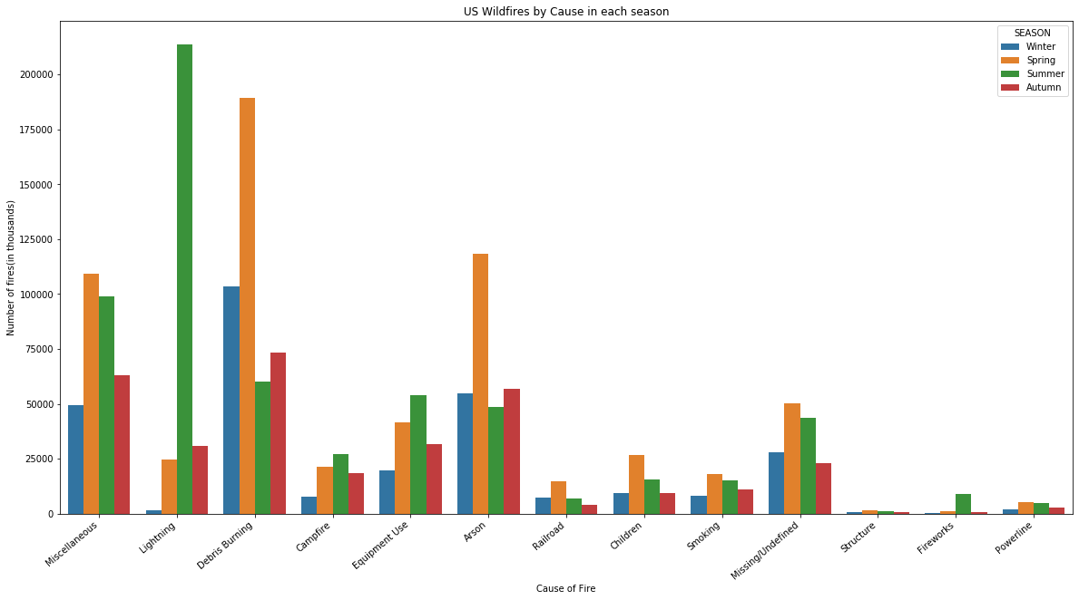
"Cause of Fire" and "Season" are not independent.
we can also note that Lightning during Summer causes most wildfires.

Slide 24
Machine Learning-Predicting the cause of Fire
Select features to build model
Features/Predicted Variable = FIRE_YEAR,STATE,LONGITUDE,LATITUDE,MONTH
Target Variable = STAT_CAUSE_DESCR
I have used Supervised learning with training and test datasets
Split the data in 30% for testing and 70% for training.
Convert all non-numeric features like the cause of the fire and state name to numeric values.
I have evaluated Decision Tree, Random Forest Classifier and Gradient Boosting Decision Tree models with prediction score 47%, 57% and 17% respectively.

Slide 25
Random Forest Classifier
Prediction score of this model is approximately 57%, with Training data accuracy 74%.
Model is overfitting . Overfit model may look impressive on the training set but will be useless in a real application.
Tune the hyperparameter
The standard procedure for hyperparameter optimization for overfitting is through cross-validation.
Using Scikit-Learn’s RandomizedSearchCV method, we can define a grid of hyperparameter ranges and randomly sampled from the grid, performing K-Fold CV with each combination of values.

Slide 26
Hyperparameter Tuning
Random Forest classifier with the default parameters other than for n_estimator value which I have chosen to be 60
A higher n_estimator may yield better results, but I am running into timeout/memory error with higher values.
Using the below random grid parameters to search for best hyperparameters.
{'bootstrap': [True],
'max_depth': [90],
'max_features': ['auto', 'sqrt'],
’min_samples_leaf': [2, 4],
'min_samples_split': [5, 10],
'n_estimators': [60]}

Slide 27
Hyperparameter Tuning Contd..
Created a Random Forest Classifier model and tried to tune it by passing it to RandomizedSearchCV method along with
n_iter=100 , which controls the number of different combinations to try.
cv=3, which is the number of folds to use for cross validation.
created a Random Forest model with the best parameters obtained using the RandomizedSearchCV method.
{ 'bootstrap': True,
'max_depth': 90,
'max_features': 'sqrt’,
'min_samples_leaf': 4,
'min_samples_split': 5,
'n_estimators': 60 }
We achieved an unspectacular improvement in accuracy of 1% after using bet parameters found using random search.

Slide 28
Feature Classification
Classify cause of fire into 3 major classes and test if prediction score improves.
The 3 classes are: lightning, human_caused and Unidentified/other.
lightning = ['Lightning’]
human_caused = ['Arson','Fireworks','Powerline','Railroad','Smoking','Children','Campfire','Equipment Use’, 'Debris Burning’, 'Structure’]
Unidentified/other = ['Missing/Undefined’, 'Miscellaneous’]
Replaced STAT_CAUSE_DESCR with LABEL.
Passing the best parameter values obtained by the RandomSearchCV method.
Reducing the number of categories improved the prediction score significantly from around 58% to 80%.

Slide 29
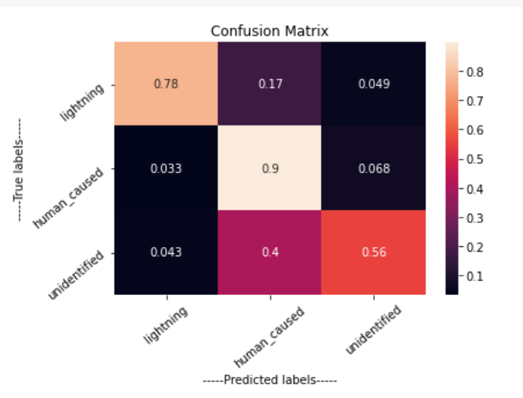
confusion matrix
The random forest algorithm did well with the first two labels: lightning(78%) and human_caused (90%)
It did not do as well with the 'unidentified' label.
It labeled 40% of unidentified labels as human_caused fire.

Slide 30
Other approaches
Created a Random Forest model to predict cause of fire only for California.
Prediction score was 66%
Taking a random sample of the full dataset and applying a Random Forest Classifier Algorithm on this sample.
Prediction score was 57%

Slide 31
Conclusion
Counties like Riverside County, San Bernardino, and San Diego in California, Coconino, and Gila in Arizona, Beltrami in Minnesota have a greater number of fires.
Yukon-Koyukuk, Stanton, and other counties in Alaska have largest fires that have destroyed over thousands of acres.
Most wildfires across the USA are caused by debris burning and arson.
Fires started by electricity(caused by lightning and Powerline) are the most damaging.
Lighting during summer causes the most dangerous fires.
Using the Random forest classifier model trained in this project, we can predict the cause of these wildfires, at least to an accuracy of 58% or better.
Reducing the number of labels(Fire Cause classes) significantly improves the prediction score to 80% for the random forest algorithm.

Slide 32
Recommendation
Smaller states like Alaska, Georgia, and Rhode Island should be prepared with the right equipment and safety measures to prevent/fight wildfires which have recklessly caused harm to the states in the past.
By educating people about local Ordinance regarding trash burning, being careful when having a campfire, using fireworks or fire pits, and implementing strict laws against arsonists we can prevent or at least reduce the number of fires caused by human negligence.
Parks in California post the risks of forest fires daily. Other states and counties should implement this too. If people are aware of the risks, they can prevent doing any activities that could end up causing a wildfire.

Slide 33


Thank You

